Slide 1

Welcome to CSCI 490/680! ☺
Modelling & Simulation

Slide 2
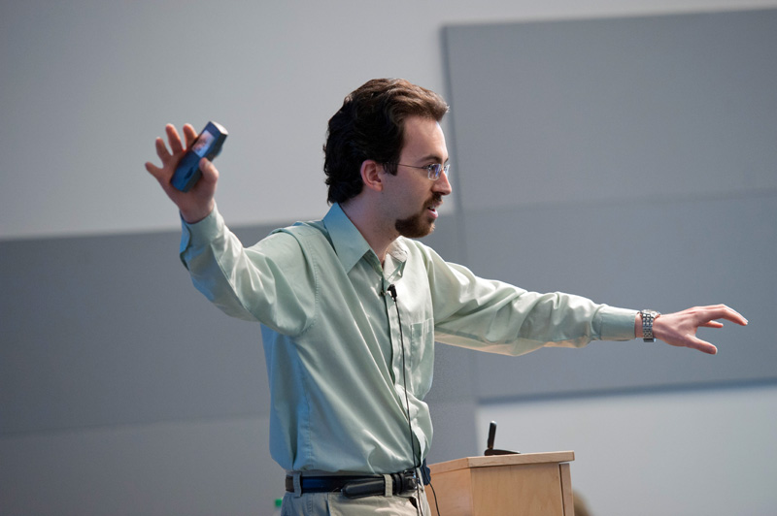
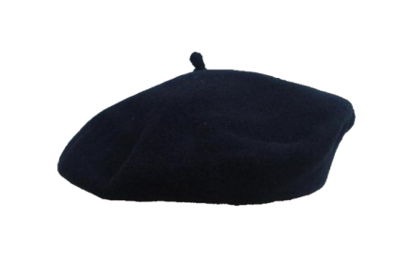

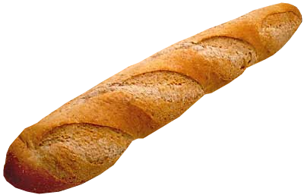
Introducing people
Dr Philippe J. Giabbanelli
that‘s me ;-)
giabba@cs.niu.edu
Office: PM461
T/Th 12:15-2:00,
3:15-4:00
2
How does this course work?

Slide 3

Topics for today
What are my expectations? What could you expect?
Format: how do you get a grade? How do we best communicate?
Pre-requisites
3
How does this course work?

Slide 4
What are my expectations? What can your expectations be?
4
How does this course work?

Slide 5

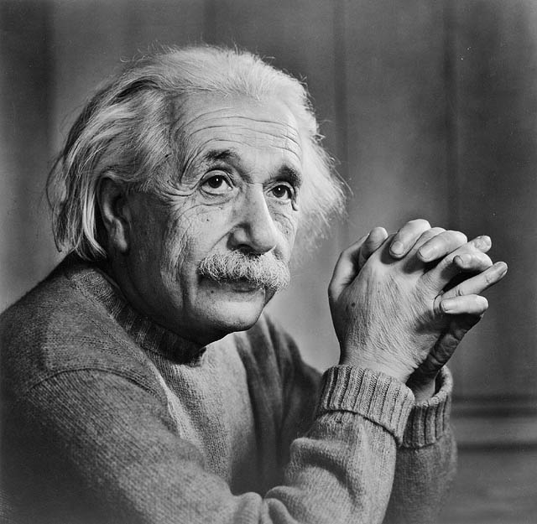
This is a research course.
By the end, you’ll be somewhere in between...
5
How does this course work?

Slide 6



This is a research course.
My
• You know how to program.
= at least one high-level language + data structures
We’ll use specific simulation software, and will also be programming (particularly for projects) in either Java or Python. Knowing one helps for projects but isn’t a pre-req.
6
How does this course work?

Slide 7

This is a research course.
My
• You know how to program.
= at least one high-level language + data structures
If I give you something to program, I assume programming isn’t going to be a problem. I won’t answer programming-related questions.
I’ll answer methodological questions.
7
How does this course work?

Slide 8
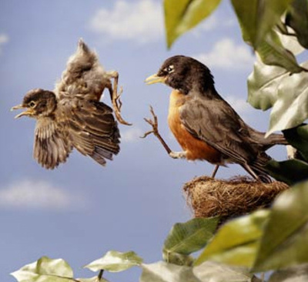
This is a research course.
My
• You are reasonably independent.
→ There is no TA for this course.
→ Occasionally I’ll ask you to use new software, and you’ll learn how to by reading and watching videos.
8
How does this course work?

Slide 9
This is a research course.
My
• This course is demanding. You’ll need to put in the work.
→ I’ve failed multiple students in every single special topics course.
→ A mandatory course (e.g. Database, Unix) slows down for students as they need to pass. A special topics course does not need to slow down.
9
How does this course work?

Slide 10

This is a research course.
Your
You will read & find (mostly recent) research articles
what could have be done better?
how does it relate to another article?
are there good ideas to apply elsewhere?
This is essential to exert a critical mind, and to continue training beyond graduation.
10
How does this course work?

Slide 11
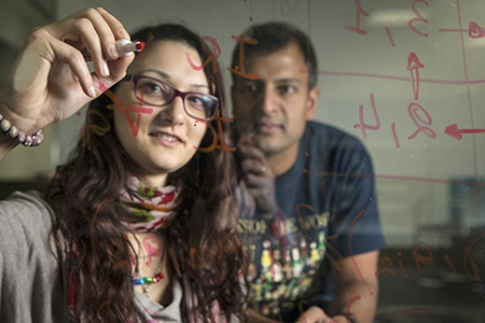
This is a research course.
Your
You will conduct a (small scale) research project
Questions that can be investigated within a term have been designed for you.
You will work in a team to answer them. You are not graded on the answer itself (we don’t know what it will be!) but on the soundness of your methods.
You need to be a professional, and apply methods rigorously in a team setting.
11
How does this course work?

Slide 12
This is a research course.
Your
The reasons why research projects have been designed for you are:
• They’re feasible within the time frame.
• They are research project, so we’re doing something new and useful beyond just this class.
• I understand the project well-enough to give you directions.
When you start your PhD, then it’s time to design your research project. For now, you need to learn how to get one done ☺
12
How does this course work?

Slide 13
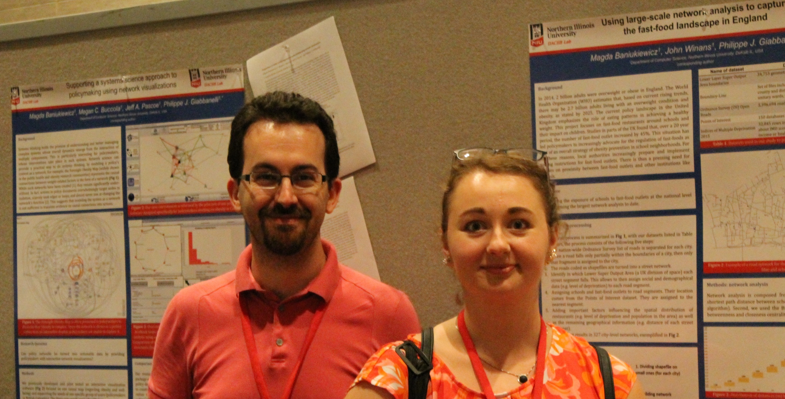
This is a research course.
Your
In a previous special topics course, the students’ work was featured at an international conference via 4 posters.
13
How does this course work?

Slide 14
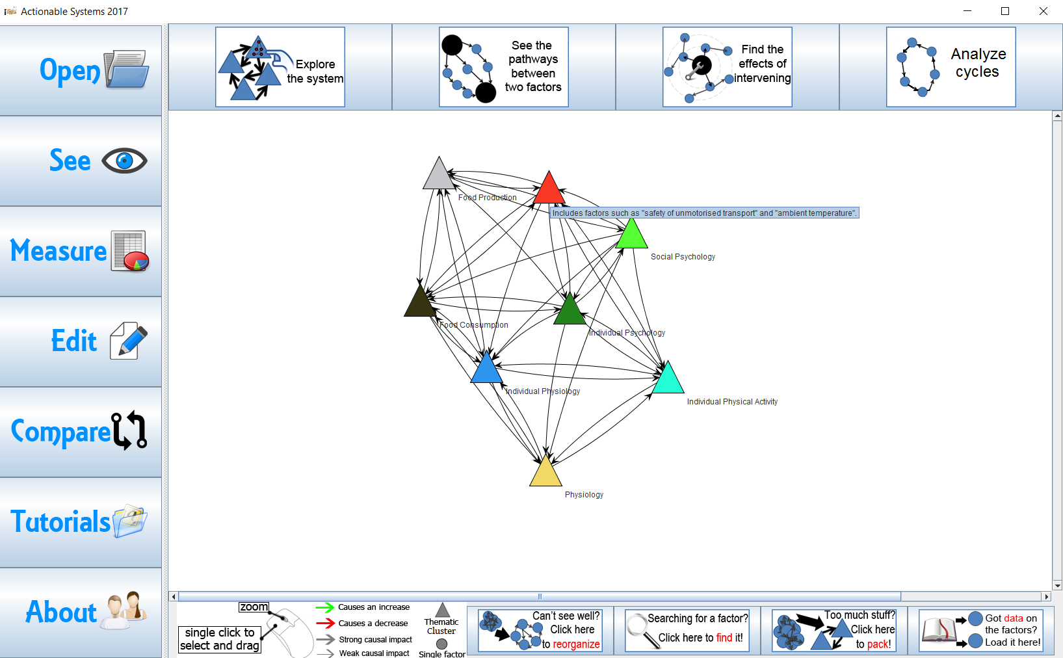
A software used in this course, ActionableSystems, was developed as a class project.
This is a research course.
Your
14
How does this course work?

Slide 15
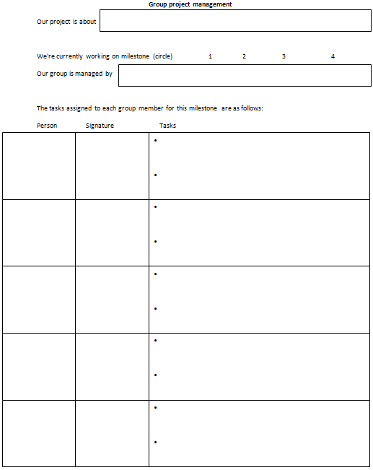

This is a research course.
Your
There is no “free ride” by being in a team.
15
How does this course work?

Slide 16



Which project will you work on?
It will depend on 3 factors.
Your own preferences.
The balance of skills in your team, in relation with the project.
Who you like working with/who likes working with you
16
How does this course work?

Slide 17

This is a research course.
Your
We’ll finish covering format (grading, emails, disability, etc.).
The next lecture will start with the actual content.
17
How does this course work?

Slide 18
Format
18
How does this course work?

Slide 19
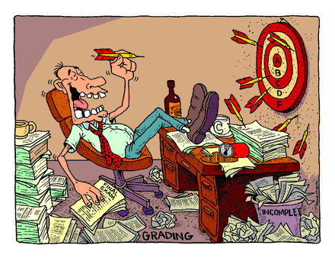
Grading
50% project
In several parts, and in a team.
20% assignments
Several assignments, weight based on difficult and length
30% quizzes
All quizzes are worth the same. The number depends on class progress.
100%
No big exam like midterm or final.
19
How does this course work?

Slide 20
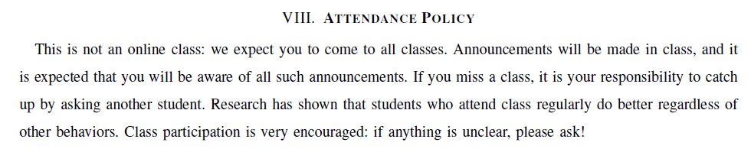

Outline Section III: Grading
• There are no ‘surprise’ quizzes. A quiz will always be announced in advance, at least one class before.
• To do exams such as quizzes in good conditions, the door may be closed a few minutes after the exam starts. Nobody will be let inside until the exam is done.
30% quizzes
20
How does this course work?

Slide 21


Outline Section V: Specific procedures
• After you receive a grade, you have one week to contest it; for the final exam, that is 1 day. After this, the grade shall not be discussed.
• To contest, you must detail what you think was not fairly graded. If the reason is valid, re-grading may result in a higher or lower grade.
Only fairness matters. If you’re about to fail the course and miss a job offer, that won’t lead to re-grading anything.
Repeated emails to attempt changing a grade after it’s been denied, or coming to the office to attempt changing a grade... are forms of harassment.
21
How does this course work?

Slide 22


Outline Section IX: Accessibility
• If, at any point, you are not well physically or mentally, go to the DRC (http://www.niu.edu/disability/). Once you get a letter of accommodation from them, I can arrange things for you going forward.
• If your situation changes, get a new letter from the DRC.
22
How does this course work?

Slide 23


Grading
Assignments are all submitted through the course website. The submission server closes at the deadline.
I will try to give you a fast feedback, so everyone’s work has to be in at the same time.
You can submit as many times as you want, up to the deadline. So send backups!
23
How does this course work?

Slide 24

Grading
When a submission is sent on behalf on multiple people, only one person submits for the group.
It’s up to the group how to handle this. If the ‘person in charge’ does not submit, you’re equally responsible for getting 0.
• Set an internal submission deadline.
• The person in charge must submit by this deadline and send a proof of submission to all others.
• If the proof of submission is not received, someone else needs to take leadership and submit.
Welcome to deliverables in the real-world ☺!
24
How does this course work?

Slide 25
Grading
Students should be learning, and given equal opportunities.
• If you ask your parent or friend to help you with your assignment, that is not equal opportunity. Your classmates don’t all have access to that resource.
• “Working together” is only valid in a group project/assignment. When a task is individual, we want to know what you can do.
Should your classmate have better grades because their dad is richer? Should they have better grades because their dad knows programming?
Breaking the rules results in 0 or failing the course. No free pass.
I report all offenses to NIU. It goes on records.
NIU will tell a prospective employer about your records.
25
How does this course work?

Slide 26
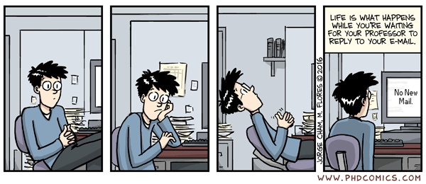
Efficient Emails
26
How does this course work?

Slide 27

Efficient Emails
1. This is a research course.
We don’t know what’s the answer to a research question. That’s kind of the point. And it’s up to you to find out.
→ I cannot confirm the answer (we don’t know what it was going to be).
→ I will not fix your code.
→ I will help you apply the right methods.
27
How does this course work?

Slide 28

Efficient Emails
2. The class will work on a variety of projects.
I try, but cannot guarantee, to remember all of the details of what you’ve done in the past few weeks.
I need sufficient context to help you with your question. Where are you at? What were you trying to do? Why? What went wrong?
28
How does this course work?

Slide 29


Efficient Emails
3. If you think you need a good amount of help then come to the office hour, it’s going to be a lot more efficient than endless emails!
« Sir can I see you in 2 days (Friday) to discuss how to validate an agent-based model in Anylogic? »
« Sir I am lost can I see you this afternoon »
29
How does this course work?

Slide 30

Efficient Emails
4. Do not expect your emails to be answered minutes before a deadline
30
How does this course work?

Slide 31

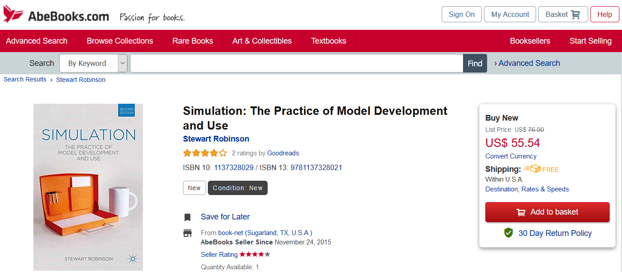
The One Book
This book is required. So I will assume you all have it and assign readings/assignments using it.
The bookstore has been notified and should have enough stocks. But don’t wait too much.
http://www.palgrave.com/page/detail/Simulation/?K=9781137328021
List price: $76
31
How does this course work?

Slide 32


The One Book
What can I do with an older edition of the book?
Alternatively...
32
How does this course work?

Slide 33
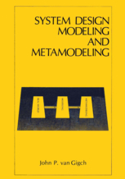

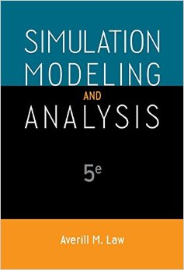
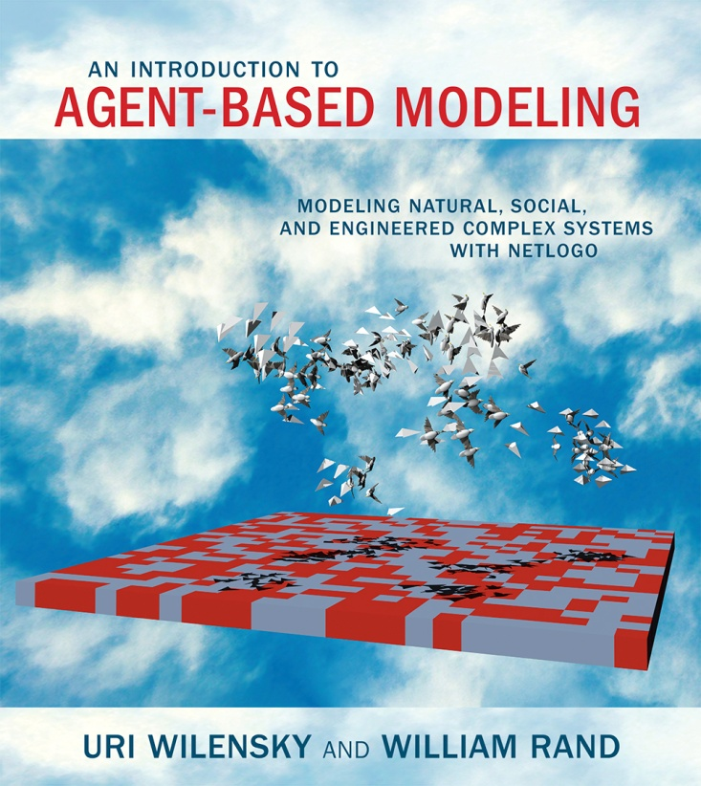

The Other Books
Every modeller has a slightly different approach. This is what’s at the top of my library, and what you’ll see in the course.
33
How does this course work?

Slide 34
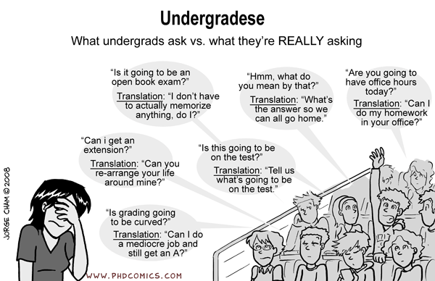
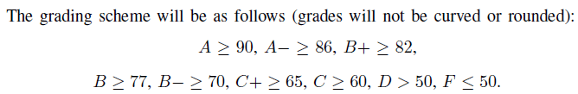
Other questions
/
/
We always guarantee that F ≤ 50. Other categories vary based on overall class performance.
34
How does this course work?

Slide 35

35
How does this course work?

Slide 36
Pre-requisites
36
How does this course work?

Slide 37

Programming in a high-level language and data structures are necessary to be successful in this course. MATH206 is a strong asset.
We’ll now test these pre-reqs, as well as abstraction and problem-solving skills.
The outcome will be visible on the course website by the end of the day. You’ll see “F” (fail) or “P” (pass). If you get an F, you may consider dropping the course because you’re not ready. If you get a “P” and you want the course, then get the book so you can do your homework.
37
How does this course work?

Slide 38

Quiz 1 coming on Tuesday!
In preparation, read & watch:
• Textbook, chapter 1
• Epstein, J.M. Why model? Journal of Artificial Societies and Social Simulation 2008, 11(4):12.
http://jasss.soc.surrey.ac.uk/11/4/12.html
• Pritsker, A.A.B. Why simulation works. Proceedings of the 1989 Winter Simulation Conference.
Shortened version on the course website
• Chuck Turnitsa, what are simulations. https://www.youtube.com/watch?v=H4GT1PlK2Go
• Computational Sociology. Shortened version on the course website
And if you just feel like it...:
• Axelrod, R. Advancing the art of simulation in the social sciences. In “Handbook of research on nature inspired computing for economy and management”, Rennard J.-P. (eds), 2005.
http://www-personal.umich.edu/~axe/research/AdvancingArtofSim.pdf
• Gran, R. What is Simulation? (12 mins)
https://www.youtube.com/watch?v=OCMafswcNkY
• Overall modeling process: http://jasss.soc.surrey.ac.uk/13/1/10.html
38
How does this course work?

Slide 39

What will he do to us in the quiz?
You’ll take a page. Write your name and zID on it. You can use a pen, pencil, or feather quill.
You will have 20 mins to answer the questions. Just write a question’s number, no need to copy it.
Questions are usually open ended. Sample past questions:
A. In “Why Model?”, Joshua Epstein say that people have a misconception about the goal of models as being always being one thing. What is that thing, and why is it a misconception?
B. In “Advancing the art of simulation in the social sciences”, Axelrod states that the programming of a simulation model should achieve 3 goals: extendibility, usability, validity. Rank them by how important you think they are, and provide arguments for your ranking.
C. In 1989, Pritsker wrote “why simulation works”. He identified 3 research areas for the future. Fast forward to doay, which one do you think is most relevant, and why?
39
How does this course work?

